Slide 1
Discrete Fourier Transform (DFT)
Fast Fourier Transform (FFT)
Probabilistic Matric Factorization (PMF)
And potential application for matrix interpolation
Victor Devaux-Chupin

Slide 2
Fourier Transform – A recap
https://mriquestions.com/fourier-transform-ft.html
Convert a function to the frequency domain (change of basis) – Decompose a function into a sum of sine waves

Slide 3
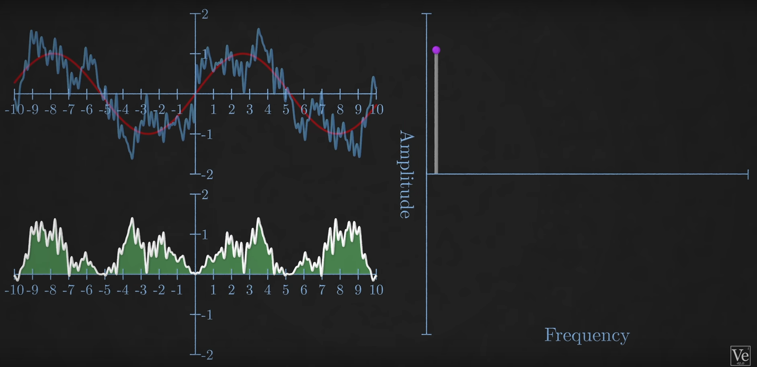
Step 1: Take the sine waves for which the product with the signal gives a non-zero area. The size of area is the relative amplitude of the sine wave.
Repeat for all waves and get the frequency spectrum
From Veritasium - The Remarkable Story Behind The Most Important Algorithm Of All Time

Slide 4
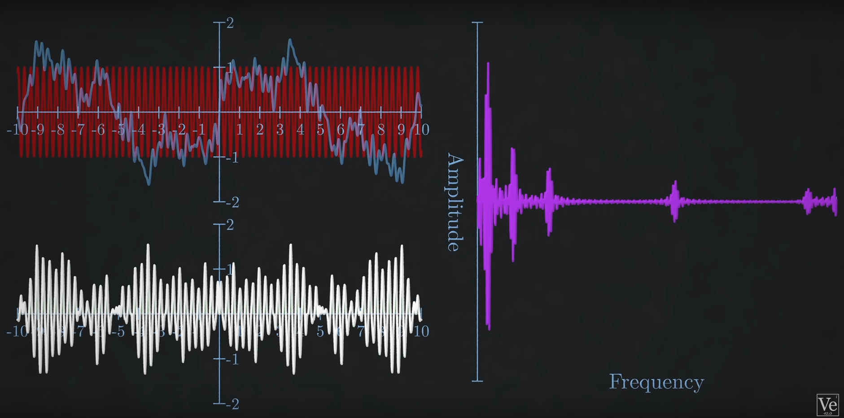
Step 1: Take the sine and cosine waves for which their product with the signal gives a non-zero area. The size of area is the relative amplitude of the sine or cosine wave.
Repeat for all waves and get the frequency spectrum
From Wikipedia
From Veritasium - The Remarkable Story Behind The Most Important Algorithm Of All Time

Slide 5
Discrete Fourier Transform ?
Our signal is now discrete, and finite (in time)
Sampling frequency will impact the frequency spectrum (lower sampling frequency = less high frequencies in the spectrum -> Nyquist Frequency)
Multiply each sine wave with each point
O($N^{2}$)
Super expensive !!!!

Slide 6
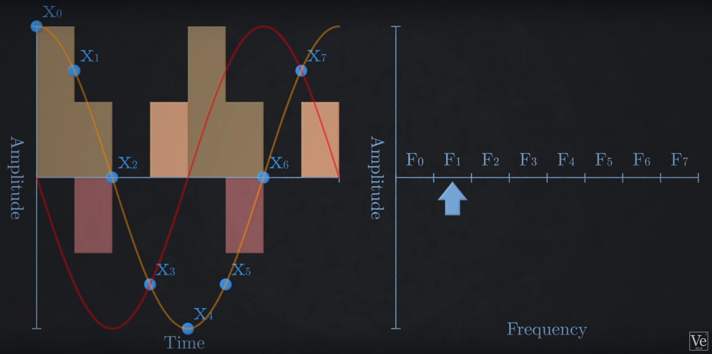
8 samples
8 frequency bins (number n corresponds to the amount of periods in the duration of the signal: F1 represent a sine wave of 1 Hz)
Multiply each point by a sine and a cosine wave of the corresponding frequency
Add them up: and it gives the amplitude
From Veritasium - The Remarkable Story Behind The Most Important Algorithm Of All Time

Slide 7
Issue:
To compute DFT: you need to multiply N points by N sine waves: O($N^{2}$)
Need to come up with a solution for faster computation: Fast Fourier Transformation (FFT)
Cooley Tuckey algorithm (Cooley, James W., and John W. Tukey. "An algorithm for the machine calculation of complex Fourier series." Mathematics of computation 19.90 (1965): 297-301.)
Useful: sine waves are periodic -> overlap over the frequencies

Slide 8
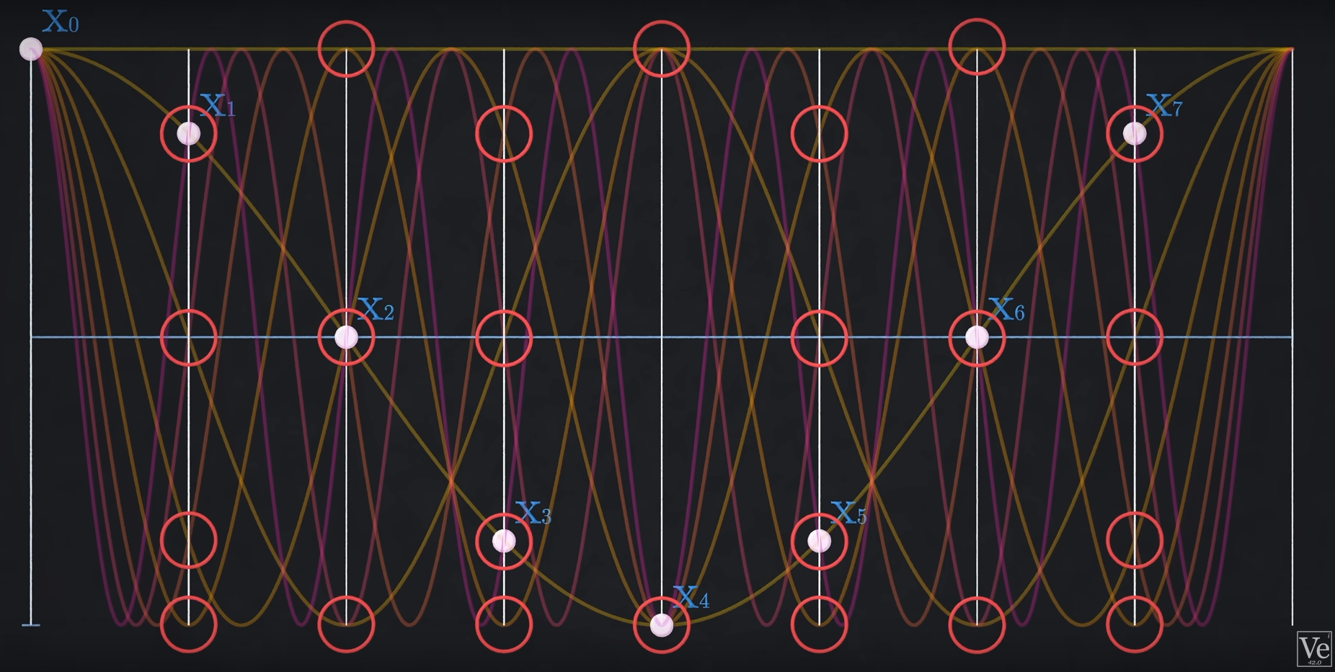
Waves intersect multiple times over the same points: less calculations needed
In our case: of 64 calculations (8 per point)
(only cosines are represented on the graphic otherwise is would be too cluttered)
Each wave crossing along the line going through a point is a multiplication. Each red circle represents overlapping multiplications: 24 calculations instead of 64
From Veritasium - The Remarkable Story Behind The Most Important Algorithm Of All Time

Slide 9
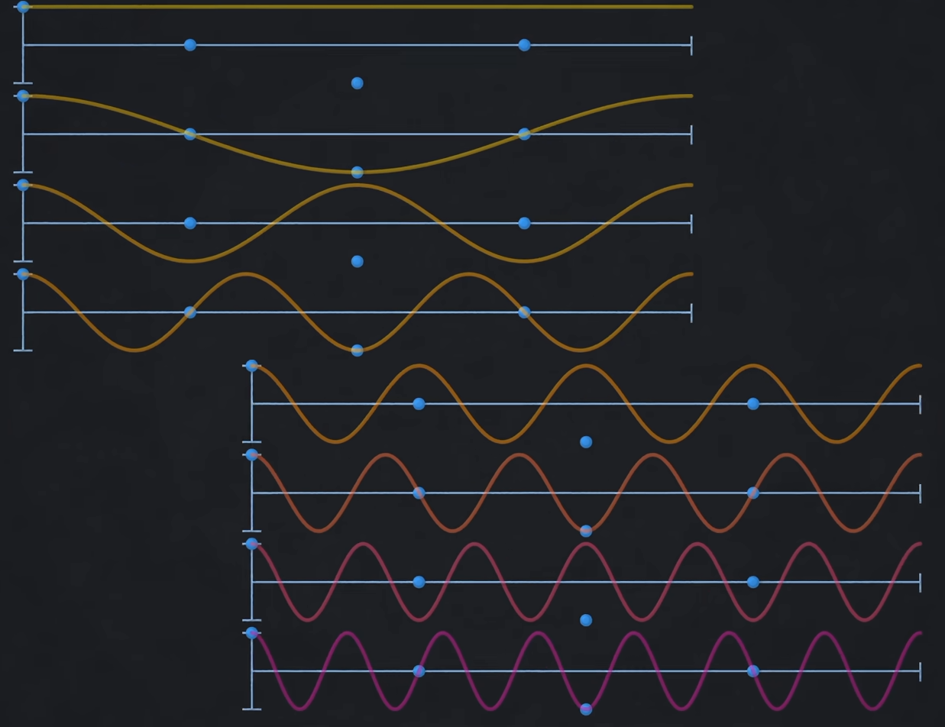
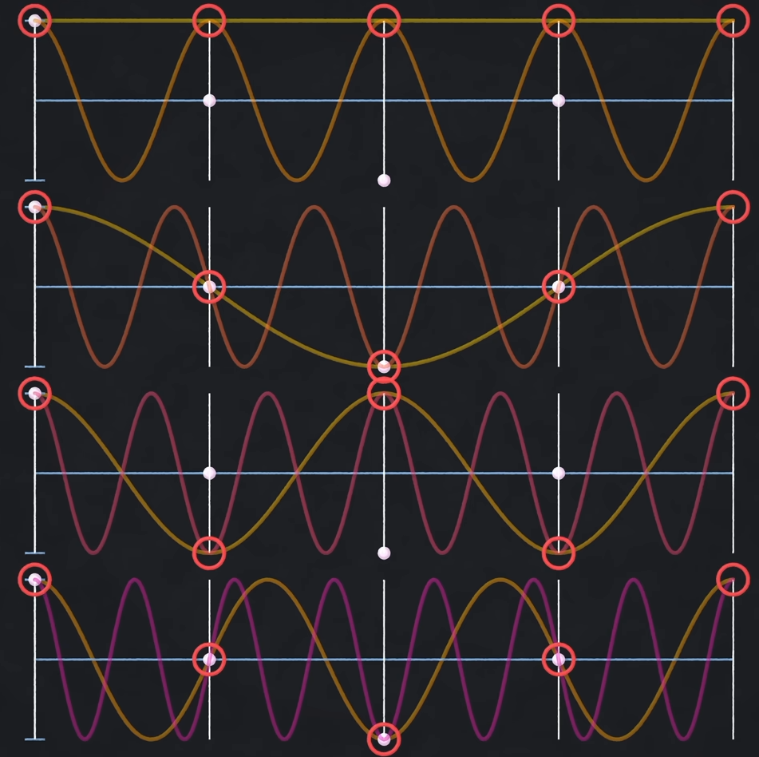
How to find which calculations overlap ? You recursively break down your sample size.
Separate your samples into odd and even indices Divide (bit-reversal in this case)
Multiply each of them by the frequency waves
By comparing the first half of the frequency waves to the 2nd half, we can see they overlap at each sample point
Conquer
(Combine)
From Veritasium - The Remarkable Story Behind The Most Important Algorithm Of All Time
Indices: 0, 2, 4, 6
For odd indices: the values of pair sine waves are the negative of the other

Slide 10
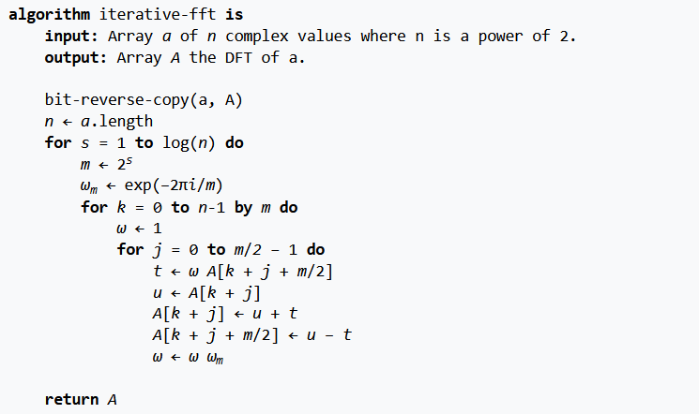
Implications:
You divide by 2 the amount of computations at each step.
Repeat over and over until you are down to single points. Each split uses sine waves’ symmetry and cuts computation by 2 -> O($N\log_{2}N$)
You basically break down the main DFT into smaller DFTs, to the point you are down to single sample size DFTs.
From Wikipedia

Slide 11
DFT vs FFT
From O($N^{2}$) to O($N\log_{2}N$)
So many applications for FFT ! (sampling, compression, matrix factorization, used everyday in your phone and computer, but also in your brain !!)
But since its (re)discovery (Gauss was the first one to discover), no improvement in the computational cost
Improvements ? DFT approximation (used mostly in parallel computation to reduce communication between processors, which is costly); probabilistic approximate algorithms can consider K of N nonzero Fourier coefficients and achieve O($K\log_{2}(N)\log_{2}(\frac{K}{N}$))
Still today, numpy cites Cooley and Tukey (1965) as the only source for their fft on the function’s page. Even though they use variants of this algorithm (Bluestein’s).

Slide 12
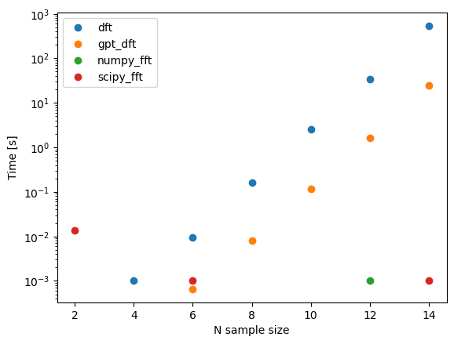
Python implementation
Handmade DFT
Chat-GPT DFT (originally appearing on https://jakevdp.github.io/blog/2013/08/28/understanding-the-fft/)
Numpy and Scipy FFT
Both use C implemented FFT
Apparently Scipy is supposed to be faster for large datasets

Slide 13
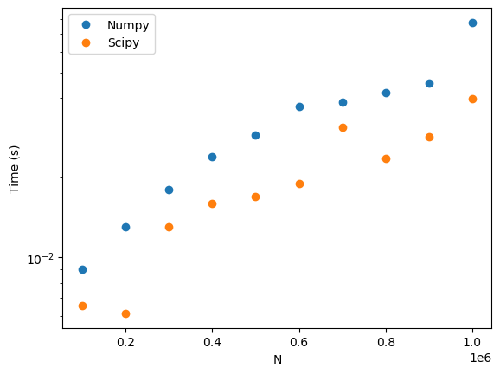
Python implementation
Scipy is faster. No idea why. Both Numpy and Scipy use Bluestein’s algorithm
Bluestein’s algorithm (Chirp-z transform) seems to be a more general implementation of Too
FFT implemented in C and then called by Python. Can also be hardware implemented directly.

Slide 14
The O($N\log_{2}N$) lower boundary seems pretty unsolvable. But can the FFT be used in itself as an optimization method ?
In my field, data can be sparse. How to interpret it the ‘best’ way possible ?
Promising technique: Probabilistic Matrix Imputation
Uses SVD to solve Probabilistic Matrix Factorization (PMF)

Slide 15
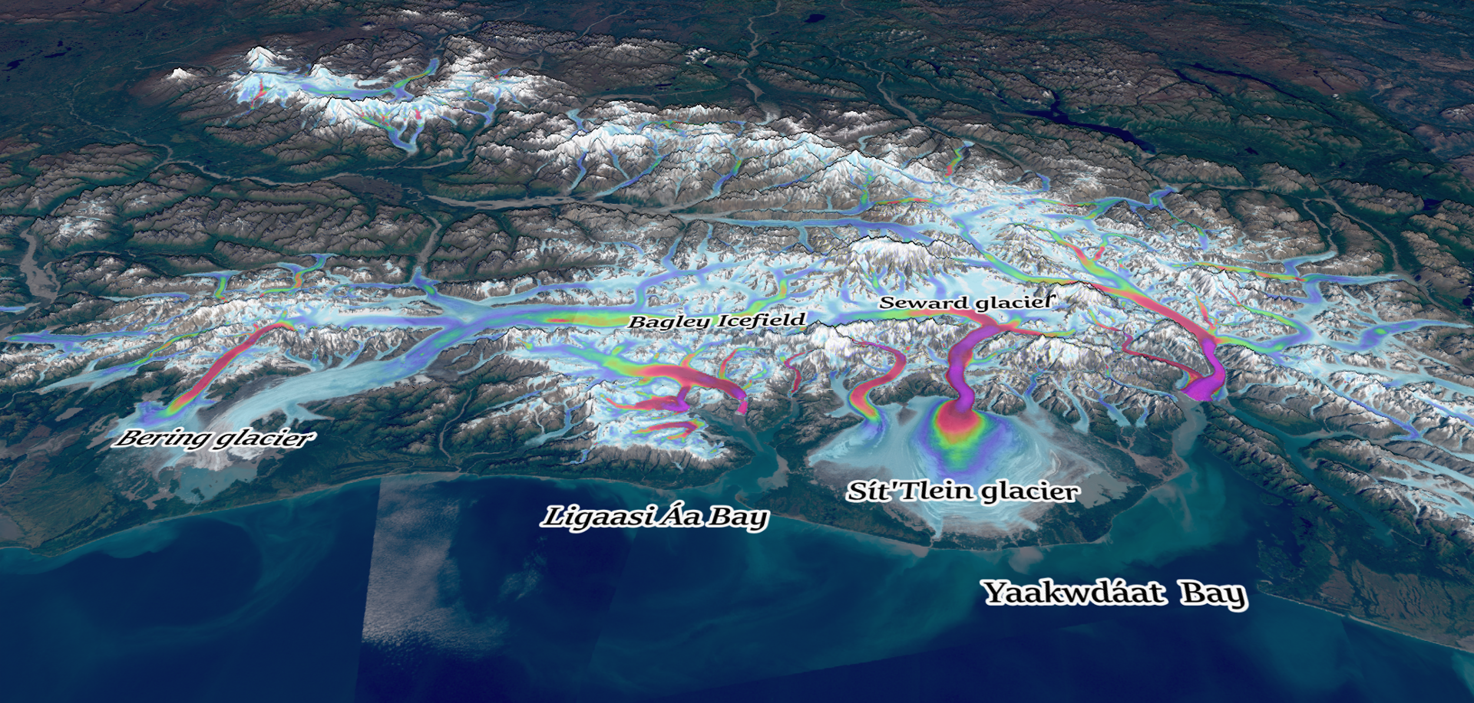
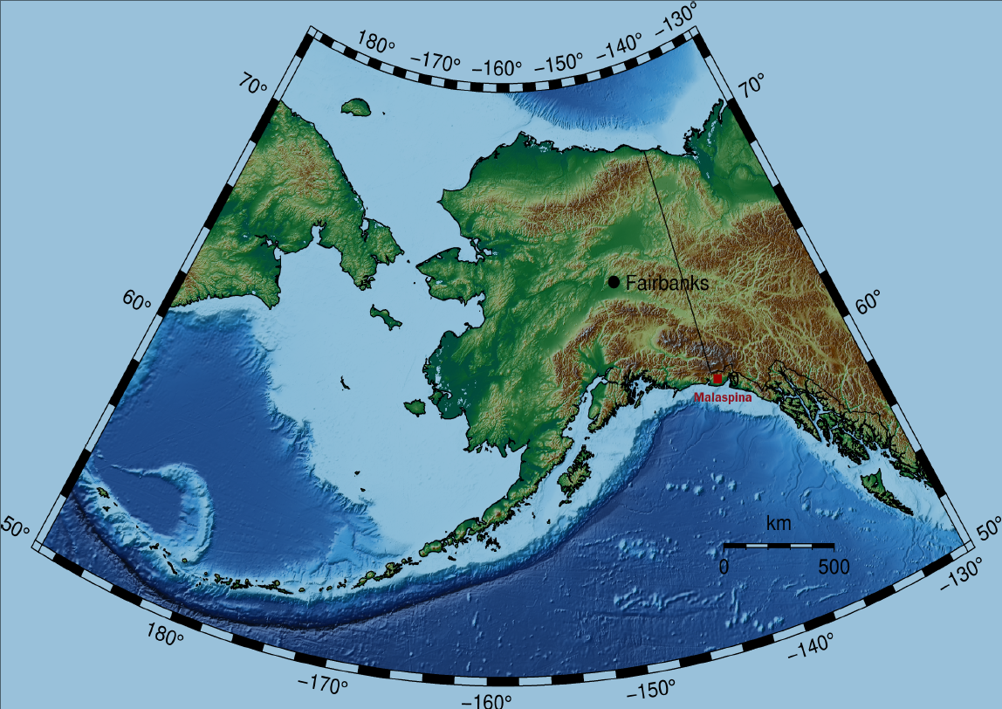
Now for a bit of data science
How to interpolate data in a ‘smarter’ way than spline, nearest neighbor, linear, etc... ?
Geophysical data has trends: the values of our variables are not entirely independant
Example: glacier surface velocities.

Slide 16
You expect values to be:
High in Summer
Low in Winter
Increasing in mid-April/May
Decreasing in September/October
Increasing during rainfalls
Slowing down after rainfalls
And maybe increase by 1 order of magnitude once in a while (surge)

Slide 17
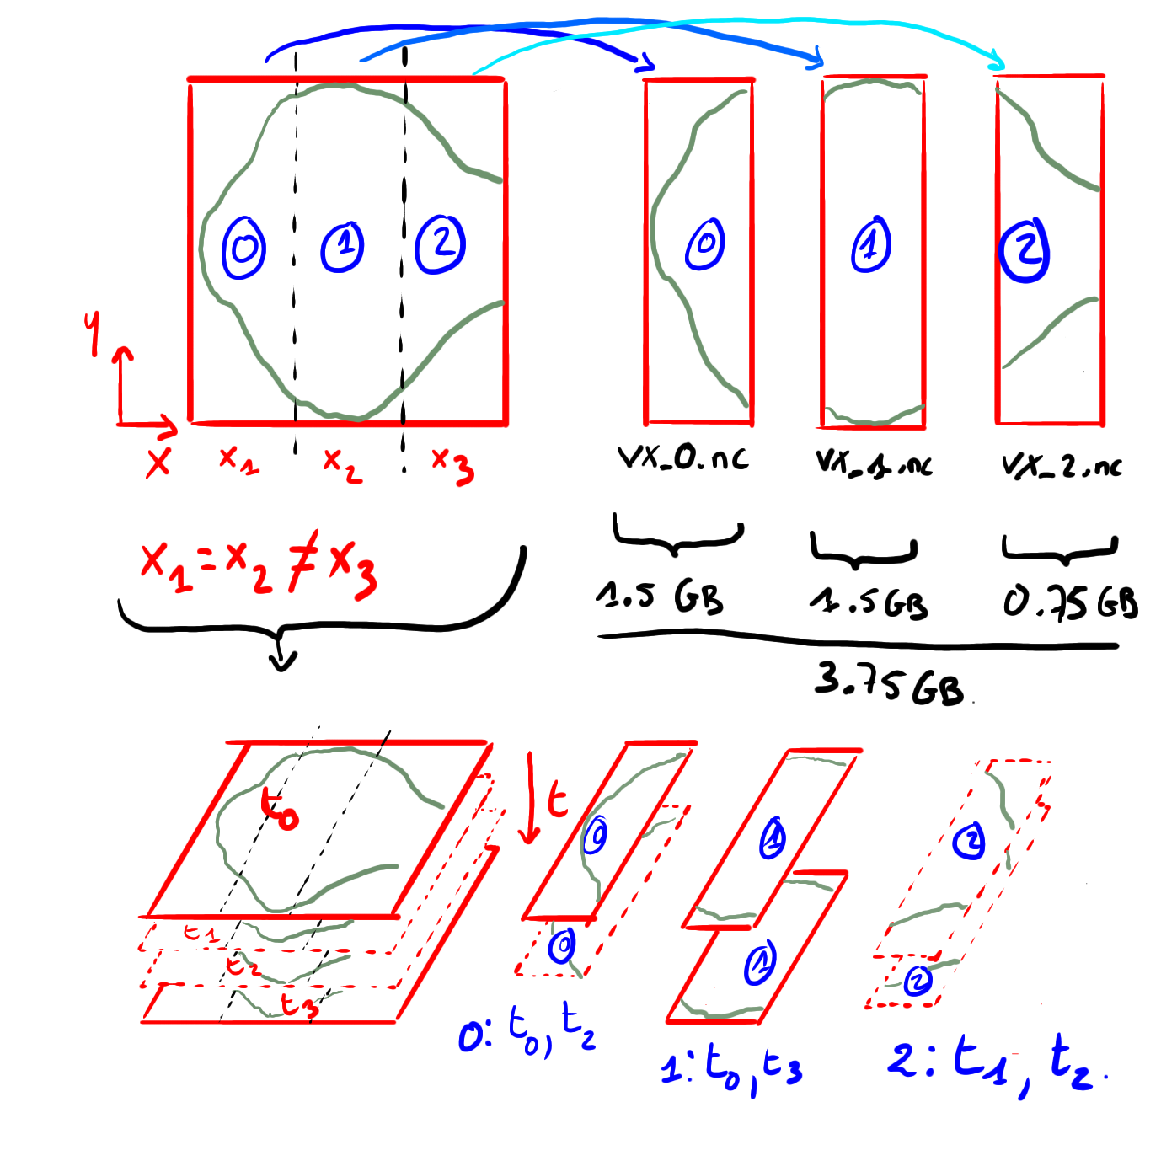
Datacube (3D matrix) – X, Y, Time
Irrgularly sampled signal: we want to change that
Use lookalike patterns to interpolate the dataset, but ‘punish’ distant patterns
We use a method derived from Probabilistic Matrix Factorization (Salakhutdinov and Mnih, 2007), based on a Bayesian approach.

Slide 18
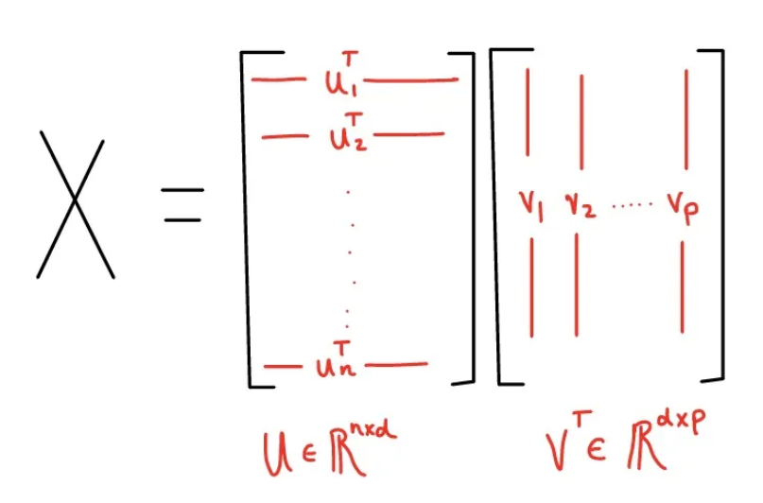
Likelyhood of the entries of X
From https://towardsdatascience.com/probabilistic-matrix-factorization-b7852244a321

Slide 19
Prior distributions on U and V
Full posterior distribution. We want to find the Maximum A Posteriori estimate (MAP) by finding U and V that maximize the posterior distribution
Equivalent to maximizing the log-posterior:
Equivalent to minimizing a loss function (with various regularizations):

Slide 20
We apply a Singular Value Decomposition on (UV) to recover the principal modes of the interpolated matrix (UV), and then recompose the interpolated matrix depending on a chosen amount of modes (reduces noise-related modes that way):
$$svd\left(UV\right)=u, s, v$$
$$X_{reconstructed}=usv^{T}$$
From https://towardsdatascience.com/probabilistic-matrix-factorization-b7852244a321

Slide 21
Limitations and questions
Regularization factors are chosen via a knowledge of the dataset, and trial-and-error.
How to choose more automatically these factors ?
Very susceptible to noise.
Very slow and memory intensive.
Can a FFT of the incomplete dataset help understand the dataset and choose the regularizations ?
SVD and FFT both are changes of basis. SVD gives information on modes rank, while FFT gives information on frequency rank.
Applying Principal Component Analysis (PCA) through a SVD on the FFT of the interpolated dataset ?
Can we compress the X matrix with the FFT in order to apply the imputation faster ?
Can the two methods be used together to speed-up the process of matrix interpolation, but also help recognize patterns in the dataset ?

Slide 22
References:
Cooley, James W., and John W. Tukey. "An algorithm for the machine calculation of complex Fourier series." Mathematics of computation 19.90 (1965): 297-301.
Bluestein, Leo. "A linear filtering approach to the computation of discrete Fourier transform." IEEE Transactions on Audio and Electroacoustics 18.4 (1970): 451-455.
Veritasium - The Remarkable Story Behind The Most Important Algorithm Of All Time : https://www.youtube.com/watch?v=nmgFG7PUHfo
https://towardsdatascience.com/probabilistic-matrix-factorization-b7852244a321
Briggs, William L., and Van Emden Henson. The DFT: an owner's manual for the discrete Fourier transform. Society for Industrial and Applied Mathematics, 1995.
https://en.wikipedia.org/wiki/Cooley%E2%80%93Tukey_FFT_algorithm
https://mriquestions.com/fourier-transform-ft.html
https://en.wikipedia.org/wiki/Fourier_transform

